Slide 1
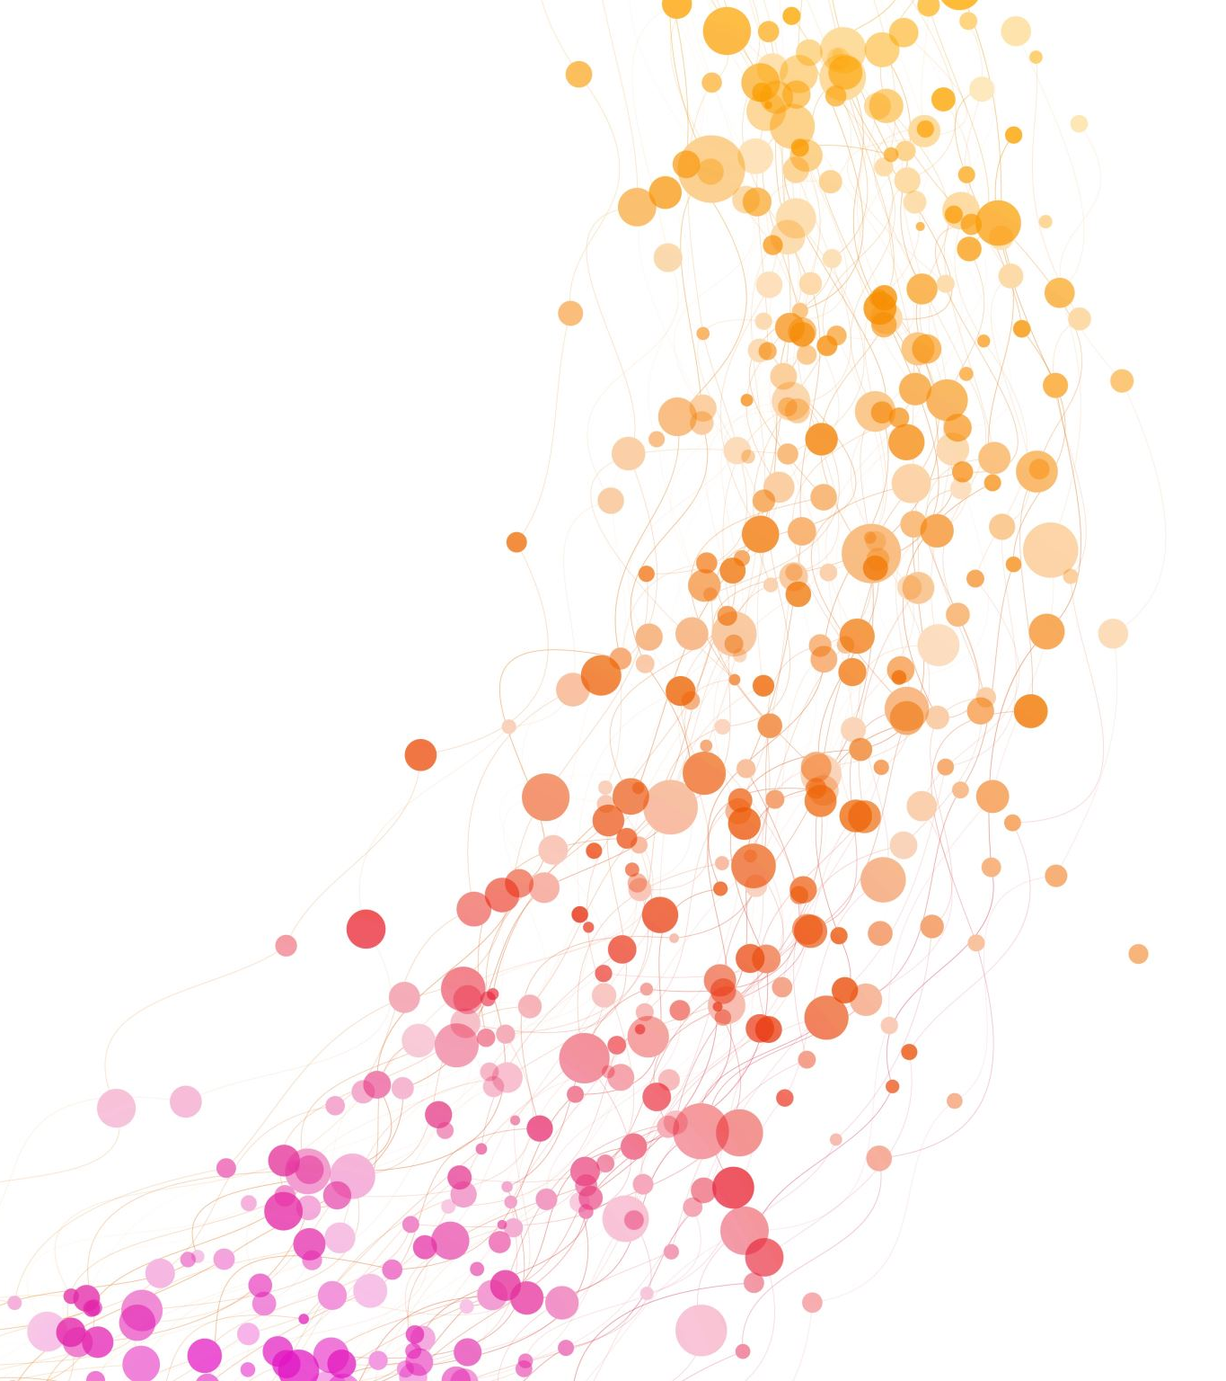
COST- Unit 5
Least Square Parabola

Slide 2
Regression
Regression analysis is a statistical method that helps us to analyse and understand the relationship between two or more variables of interest.
Regression curve of Y on X : to estimate the value of a variable Y corresponding to a given value of a variable X
Regression curve of X on Y : to estimate the value of a variable X corresponding to a given value of a variable Y

Slide 3
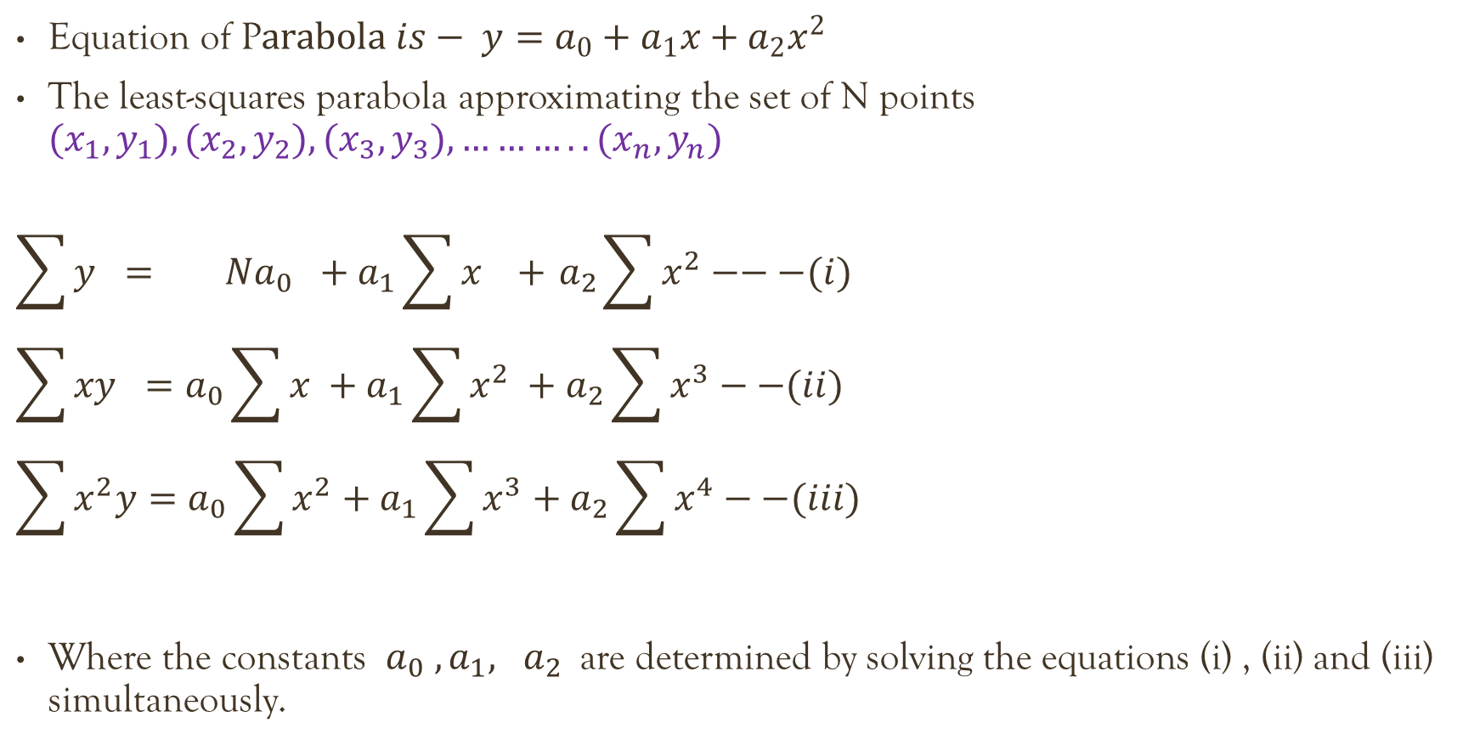
Least Square parabola
Equation of P$arabola is− y=a_{0}+a_{1}x+a_{2}x^{2}$
The least-squares parabola approximating the set of N points ${(x}_{1},y_{1}), {(x}_{2},y_{2}), {(x}_{3},y_{3}), ………..{(x}_{n},y_{n})$
$$\sum{y} = Na_{0} +a_{1}\sum{x} +{ a}_{2}\sum{x^{2}}−−−(i)$$
$$\sum{xy} =a_{0}\sum{x} +a_{1}\sum{x^{2}} +a_{2}\sum{x^{3}}−−(ii)$$
$$\sum{x^{2}y}=a_{0}\sum{x^{2}}+a_{1}\sum{x^{3}}+a_{2}\sum{x^{4}}−−(iii)$$
Where the constants $a_{0} ,a_{1}, a_{2}$are determined by solving the equations (i) , (ii) and (iii) simultaneously.

Slide 4

Question
Fit a second-degree parabola by considering X as independent variable
X | 1 | 2 | 3 | 3 | 4 | 5 | 6
Y | 2 | 6 | 8 | 10 | 11 | 10 | 9
$$\sum{y} = Na_{0} +a_{1}\sum{x} +{ a}_{2}\sum{x^{2}}−−(i)$$
$$\sum{xy} =a_{0}\sum{x} +a_{1}\sum{x^{2}} +a_{2}\sum{x^{3}}−−(ii)$$
$$\sum{x^{2}y}=a_{0}\sum{x^{2}}+a_{1}\sum{x^{3}}+a_{2}\sum{x^{4}}−−(iii)$$

Slide 5
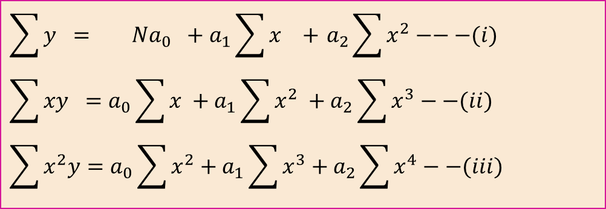
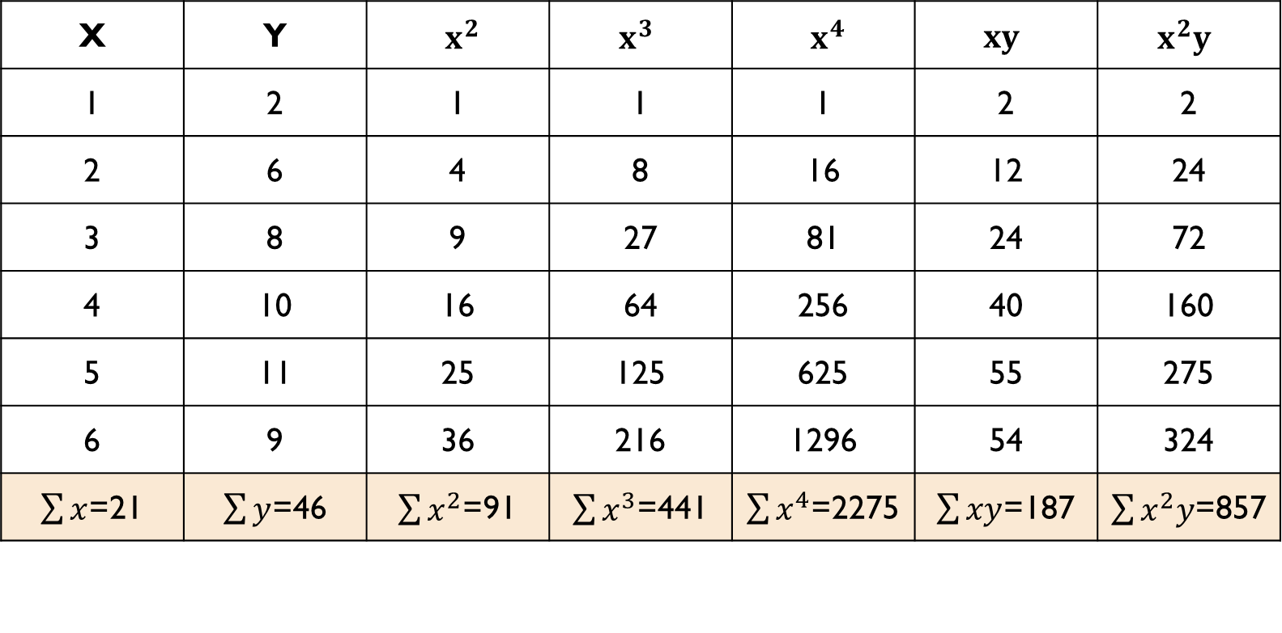
Solution
$$\sum{y} = Na_{0} +a_{1}\sum{x} +{ a}_{2}\sum{x^{2}}−−−(i)$$
$$\sum{xy} =a_{0}\sum{x} +a_{1}\sum{x^{2}} +a_{2}\sum{x^{3}}−−(ii)$$
$$\sum{x^{2}y}=a_{0}\sum{x^{2}}+a_{1}\sum{x^{3}}+a_{2}\sum{x^{4}}−−(iii)$$
X | Y | $x^{2}$ | $x^{3}$ | $x^{4}$ | $xy$ | $x^{2}y$
1 | 2 | 1 | 1 | 1 | 2 | 2
2 | 6 | 4 | 8 | 16 | 12 | 24
3 | 8 | 9 | 27 | 81 | 24 | 72
4 | 10 | 16 | 64 | 256 | 40 | 160
5 | 11 | 25 | 125 | 625 | 55 | 275
6 | 9 | 36 | 216 | 1296 | 54 | 324
$\sum{x}$=21 | $\sum{y}$=46 | $\sum{x^{2}}$=91 | $\sum{x^{3}}$=441 | $\sum{x^{4}}$=2275 | $\sum{xy}$=187 | $\sum{x^{2}y}$=857

Slide 6
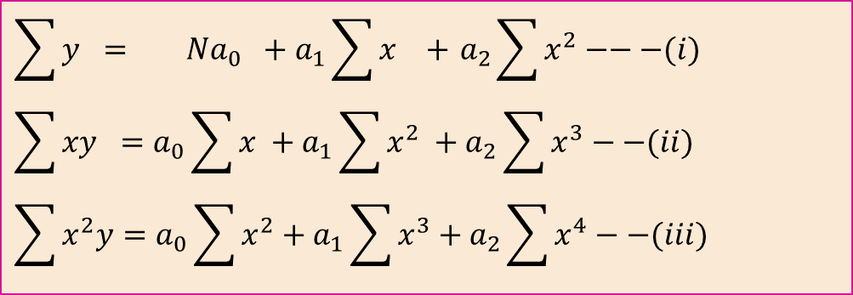
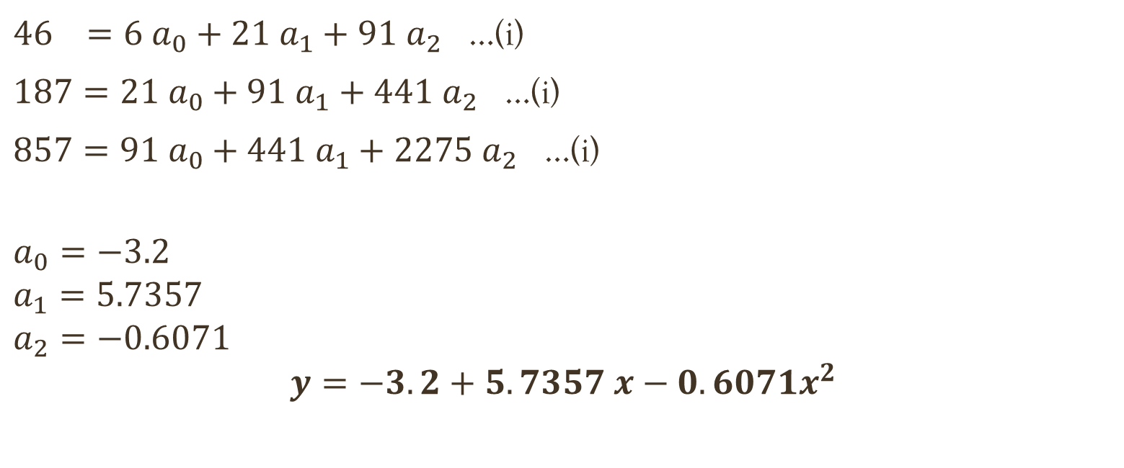
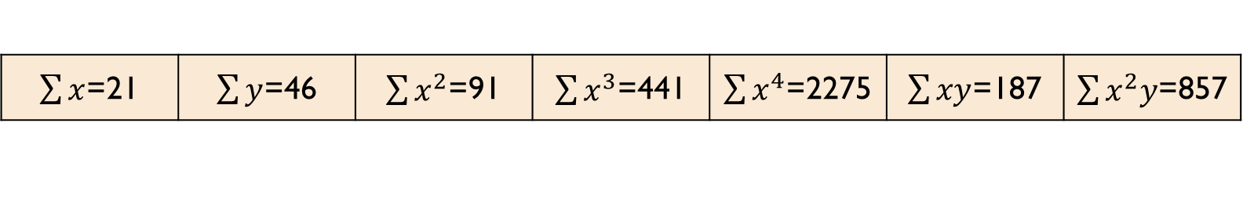
Cont. ..
$$\sum{y} = Na_{0} +a_{1}\sum{x} +{ a}_{2}\sum{x^{2}}−−−(i)$$
$$\sum{xy} =a_{0}\sum{x} +a_{1}\sum{x^{2}} +a_{2}\sum{x^{3}}−−(ii)$$
$$\sum{x^{2}y}=a_{0}\sum{x^{2}}+a_{1}\sum{x^{3}}+a_{2}\sum{x^{4}}−−(iii)$$
$\sum{x}$=21 | $\sum{y}$=46 | $\sum{x^{2}}$=91 | $\sum{x^{3}}$=441 | $\sum{x^{4}}$=2275 | $\sum{xy}$=187 | $\sum{x^{2}y}$=857
$46 =6 a_{0}+21{ a}_{1}+{91 a}_{2}$ …(i)
$187=21 a_{0}+91{ a}_{1}+{441 a}_{2}$ …(i)
$857=91 a_{0}+441{ a}_{1}+{2275 a}_{2}$ …(i)
$$a_{0}=−3.2$$
$$a_{1}=5.7357$$
$$a_{2}=−0.6071$$
$$y=−3.2+5.7357 x−0.6071x^{2}$$
$$y=a_{0}+a_{1}x+a_{2}x^{2}$$

Slide 7
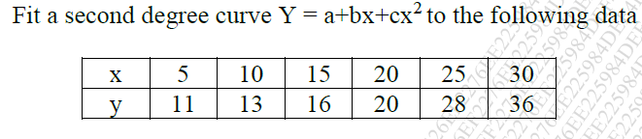
Question
Answer - Y = 11.6 - 0.2557 x + 0.0357 $x^{2}$

Slide 8

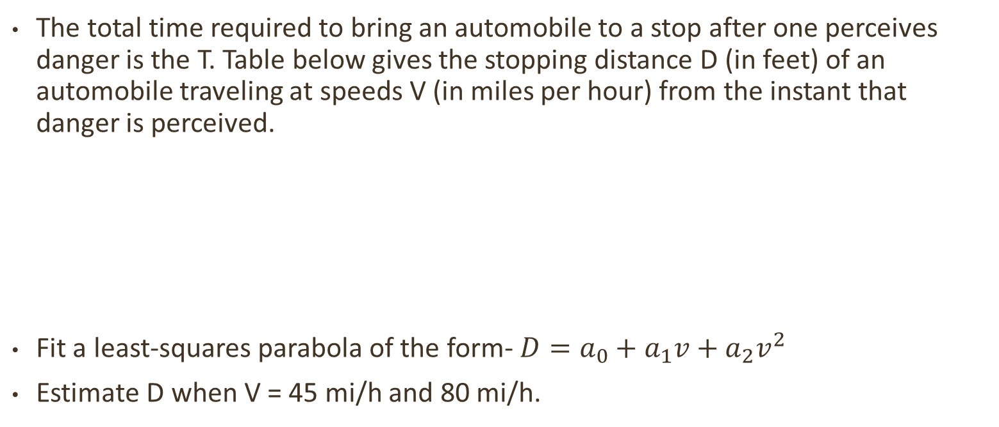
Question
The total time required to bring an automobile to a stop after one perceives danger is the T. Table below gives the stopping distance D (in feet) of an automobile traveling at speeds V (in miles per hour) from the instant that danger is perceived.
Fit a least-squares parabola of the form- $D=a_{0}+a_{1}v+a_{2}v^{2}$
Estimate D when V = 45 mi/h and 80 mi/h.

Slide 9
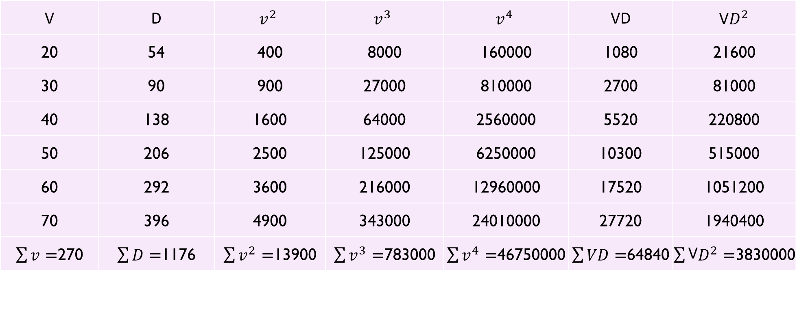
Solution
V | D | $$v^{2}$$ | $$v^{3}$$ | $$v^{4}$$ | VD | V$D^{2}$
20 | 54 | 400 | 8000 | 160000 | 1080 | 21600
30 | 90 | 900 | 27000 | 810000 | 2700 | 81000
40 | 138 | 1600 | 64000 | 2560000 | 5520 | 220800
50 | 206 | 2500 | 125000 | 6250000 | 10300 | 515000
60 | 292 | 3600 | 216000 | 12960000 | 17520 | 1051200
70 | 396 | 4900 | 343000 | 24010000 | 27720 | 1940400
$\sum{v=}$270 | $\sum{D=}$1176 | $\sum{v^{2}=}$13900 | $\sum{v^{3}=}$783000 | $\sum{v^{4}=}$46750000 | $\sum{VD=}$64840 | $\sum{\text{V}D^{2}=}$3830000

